Slide 1

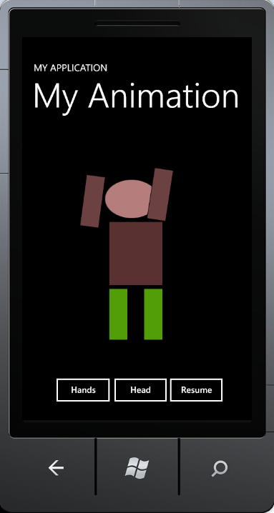
Lecture 26 Silverlight and Mobile Apps Development
CSE 445 / 598
Distributed Software Development
Yinong Chen

Slide 2
Lecture Outline
Creating Phone 7 Apps on Windows 7
Programming animation in XAML
Programming animation in C#
Upgrade to Phone 8 Apps on Windows 8
http://msdn.microsoft.com/en-us/students-develop-msdn
Calling Web services in Phone Apps
Encryption/Decryption Service
Weather Service, with asynchronous calls
Complex applications

Slide 3
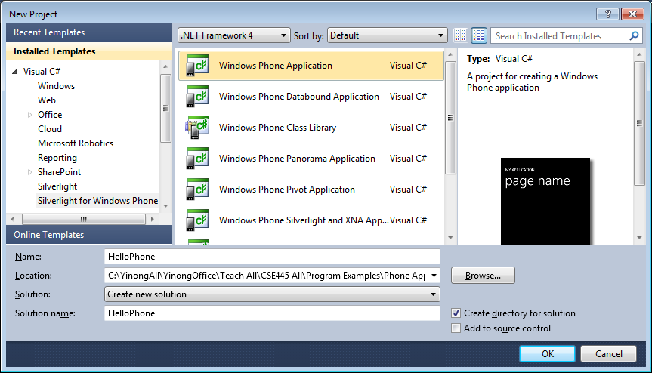
Preparation for Phone 7 App Development
Start from: http://dev.windowsphone.com/en-us/home
GET SDK: Download the latest SDK package
Install SDK, start Visual Studio, & choose template

Slide 4
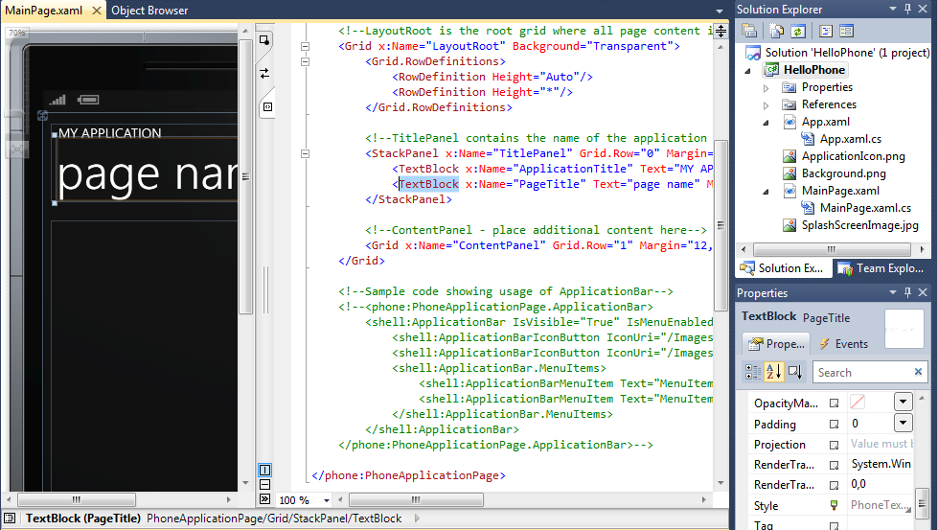
Main Page XAML View for GUI Design

Slide 5
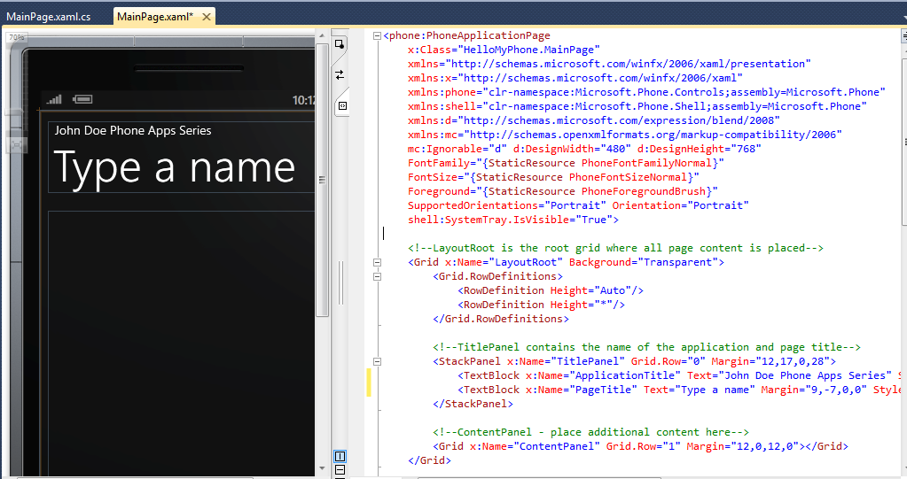
Change the TextBlock Text in XAML

Slide 6
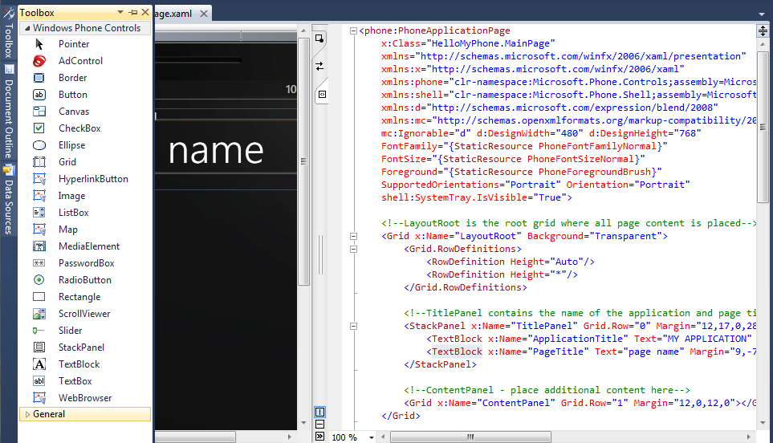
Using XAML & Silverlight Toolbox for GUI Design

Slide 7
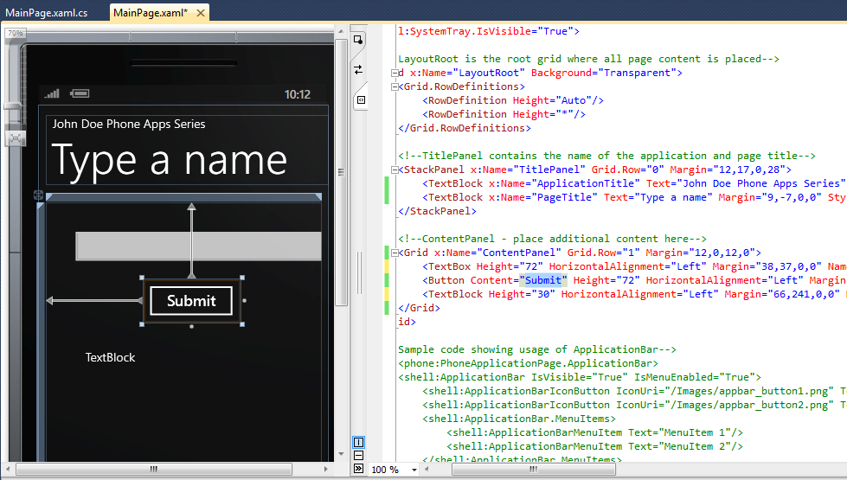
Add a Textbox, a Button, and a TextBlock

Slide 8
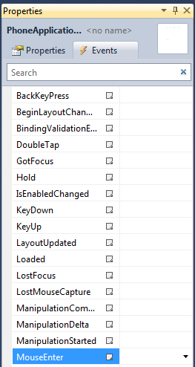
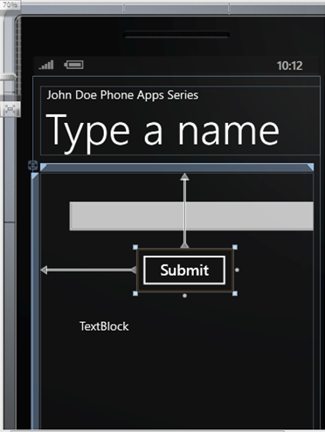
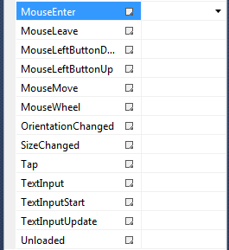
Define Events behind Textbox and Button
You can define different events to associate with different user inputs

Slide 9
XAML Code of the GUI Design
<Grid x:Name="LayoutRoot" Background="Transparent">
<Grid.RowDefinitions>
<RowDefinition Height="Auto"/>
<RowDefinition Height="*"/>
</Grid.RowDefinitions>
<!--TitlePanel contains the name of the application and page title-->
<StackPanel x:Name="TitlePanel" Grid.Row="0" Margin="12,17,0,28">
<TextBlock x:Name="ApplicationTitle" Text="John Doe Phone Apps Series" Style="{StaticResource PhoneTextNormalStyle}"/>
<TextBlock x:Name="PageTitle" Text="Type a name" Margin="9,-7,0,0" Style="{StaticResource PhoneTextTitle1Style}"/>
</StackPanel>
<!--ContentPanel - place additional content here-->
<Grid x:Name="ContentPanel" Grid.Row="1" Margin="12,0,12,0">
<TextBox Height="72" HorizontalAlignment="Left" Margin="38,37,0,0" Name="txtName" Text="" VerticalAlignment="Top" Width="460" />
<Button Content="Submit" Height="72" HorizontalAlignment="Left" Margin="161,127,0,0" Name="btnSubmit" VerticalAlignment="Top" Width="160" Click="btnSubmit_Click" />
<TextBlock Height="30" HorizontalAlignment="Left" Margin="66,241,0,0" Name="tbkDisplay" Text="TextBlock" VerticalAlignment="Top" />
</Grid>
</Grid>
namespace HelloMyPhone
{
public partial class MainPage : PhoneApplicationPage
{
// Constructor
public MainPage()
{
InitializeComponent();
}
private void btnSubmit_Click(object sender, RoutedEventArgs e)
{
tbkDisplay.Text = "Hello " + txtName.Text + ", how are you today?";
}
}
}
Code behind the GUI page

Slide 10
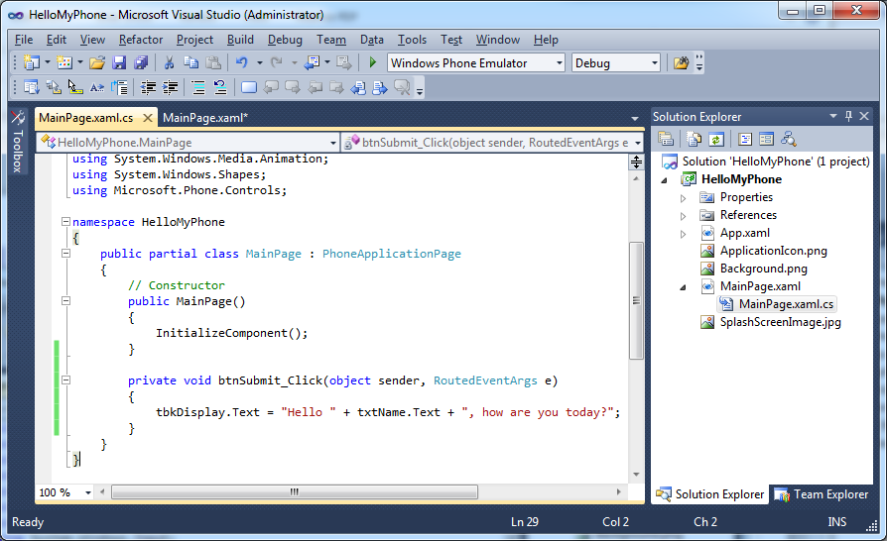
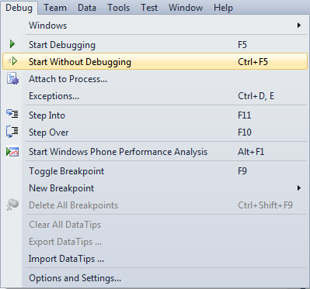
Main Page C# View for Programming

Slide 11
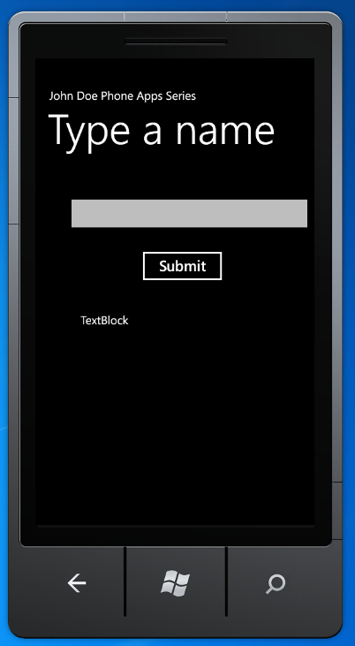
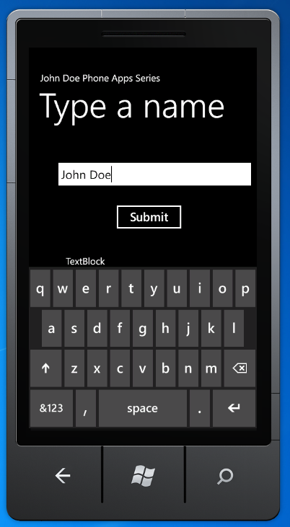
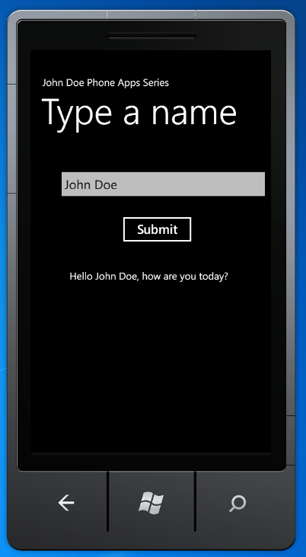
Start the Program in the Emulator

Slide 12
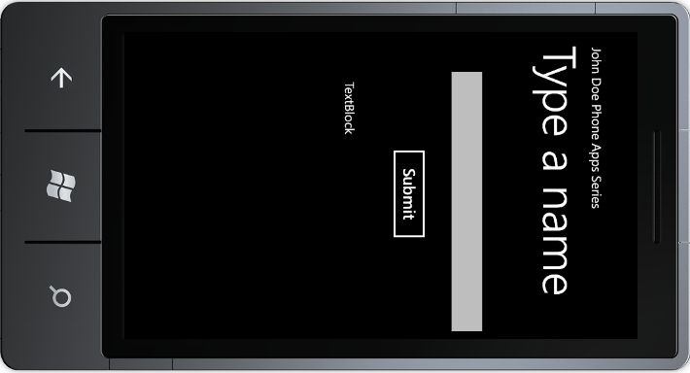
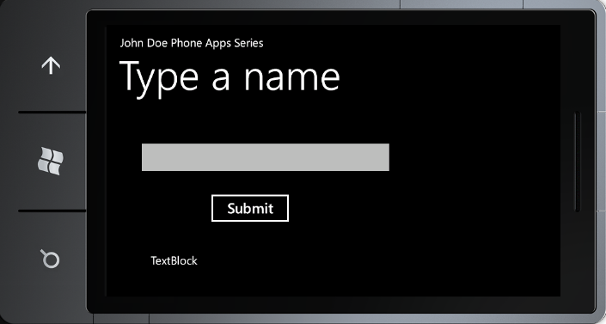

Orientation
Rotate your Phone, the GUI does not turn

Slide 13
<Storyboard> Element in XAML
Storyboard element can contain different child elements that associate different types of timelines and animations to different objects (e.g., buttons, textbox, shapes that you draw, etc.) to make the objects move by the timelines and animations.
Applications of animations that you can define include:
Make an object move automatically up and down or sideways by defined timelines.
Change its color when the user moves the mouse over a button.
Make it grow when the user selects the button.
Shrink away and then grow back to its original size when we click the button.
Fade a button when it is disabled or when it becomes unavailable.

Slide 14
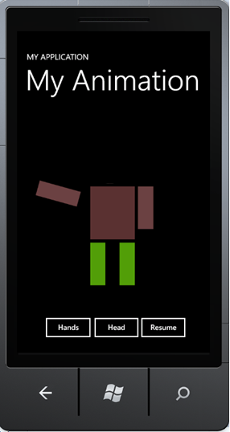
Steps of Creating Animation (1)
Selecting an object
Adding TranslateTransform elements
<Ellipse Name="ellipse1" Height="82" HorizontalAlignment="Left" Margin="169,104,0,0" Stroke="Black" StrokeThickness="1" VerticalAlignment="Top" Width="113" Fill="#FFB17F7F">
<Ellipse.RenderTransform>
<TranslateTransform x:Name="headMove" />
</Ellipse.RenderTransform>
</Ellipse>
<Rectangle Fill="#FF6C4040" Height="108" HorizontalAlignment="Left" Margin="148,206,0,0" Name="rectangle3" Stroke="Black" StrokeThickness="1" VerticalAlignment="Top" Width="40">
<Rectangle.RenderTransform>
<RotateTransform x:Name="rightArm" />
</Rectangle.RenderTransform>
</Rectangle>
Ellipse
To be defined in Storyboard
Rectangle
To be defined in C# program

Slide 15
Steps of Creating Animation (2)
Define a reference of Storyboard object. We will use:
Storyboard.Begin();
Storyboard.Pause();
to mange the object.
Adding Storyboard using animation classes
<phone:PhoneApplicationPage.Resources>
<Storyboard x:Name="myStoryboard">
<DoubleAnimation Storyboard.TargetName="headMove"
Storyboard.TargetProperty="X"
From="-10" To="10" Duration="0:0:0.50"
AutoReverse="True"
RepeatBehavior="Forever" />
<DoubleAnimation Storyboard.TargetName="legMove"
Storyboard.TargetProperty="Y"
From="-5" To="5" Duration="0:0:0.50"
AutoReverse="True"
RepeatBehavior="Forever" />
</Storyboard>
</phone:PhoneApplicationPage.Resources>
Start or Pause the storyboad
myStoryboard.Begin(); myStoryboard.Pause();
Y
X
Y
Define an operation in the object. We can define multiple operations in the object.
Define an operation in the object. We can define multiple operations in the object.
X

Slide 16
Put in a User Control in a Web App if we are developing a Web app, instead of a phone app
<UserControl x:Class="SilverlightTranslateTransformAnimation.MainPage" xmlns="http://schemas.microsoft.com/winfx/2006/xaml/presentation" xmlns:x="http://schemas.microsoft.com/winfx/2006/xaml" <Canvas Height="200" Width="200" Background="White"> <Canvas.Resources> <Storyboard x:Name="myStoryboard">
<DoubleAnimation Storyboard.TargetName="headMove"
Storyboard.TargetProperty="X"
From="-10" To="10" Duration="0:0:0.50“ AutoReverse="True"
RepeatBehavior="Forever" />
</Storyboard>
</Canvas.Resources>
<Ellipse Name="ellipse1" Height="82" HorizontalAlignment="Left"
Margin="169,104,0,0" Stroke="Black" StrokeThickness="1" VerticalAlignment="Top" Width="113" Fill="#FFB17F7F">
<Ellipse.RenderTransform>
<TranslateTransform x:Name="headMove" />
</Ellipse.RenderTransform>
</Ellipse>
</Canvas>
</UserControl>
The code is the same if you want to define a Web app.

Slide 17
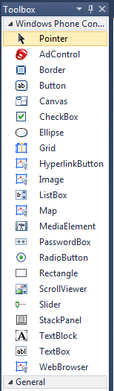
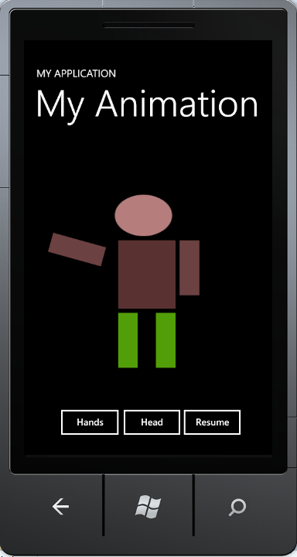
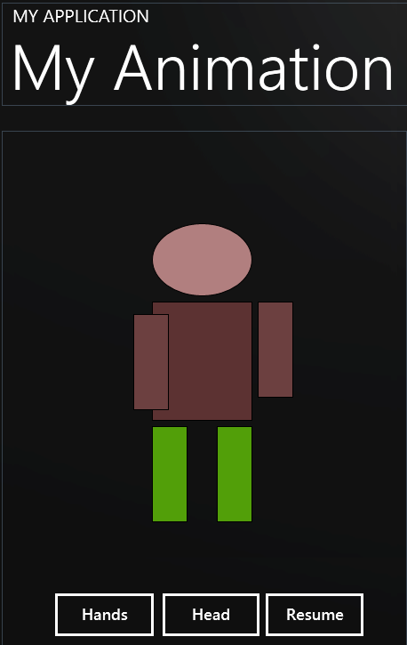
Put it in a Phone Application
Start a new phone project “MyPhoneAnimation”

Slide 18
XAML Defining the GUI (Part 1: MainPage.xaml)
Namespace generated by the template
<phone:PhoneApplicationPage
x:Class="MyPhoneAnimation.MainPage"
xmlns="http://schemas.microsoft.com/winfx/2006/xaml/presentation"
xmlns:x="http://schemas.microsoft.com/winfx/2006/xaml"
xmlns:phone="clr-namespace:Microsoft.Phone.Controls;assembly=Microsoft.Phone"
xmlns:shell="clr-namespace:Microsoft.Phone.Shell;assembly=Microsoft.Phone"
xmlns:d="http://schemas.microsoft.com/expression/blend/2008"
xmlns:mc="http://schemas.openxmlformats.org/markup-compatibility/2006"
mc:Ignorable="d" d:DesignWidth="480" d:DesignHeight="768"
FontFamily="{StaticResource PhoneFontFamilyNormal}"
FontSize="{StaticResource PhoneFontSizeNormal}"
Foreground="{StaticResource PhoneForegroundBrush}"
SupportedOrientations="PortraitOrLandscape" Orientation="Portrait"
shell:SystemTray.IsVisible="True">

Slide 19
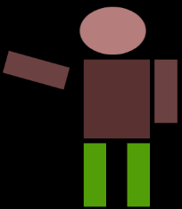
XAML Defining (Part 2: Storyboard)
Program your animation in XAML using Storyboard
<phone:PhoneApplicationPage.Resources>
<Storyboard x:Name="myStoryboard">
<DoubleAnimation Storyboard.TargetName="headMove"
Storyboard.TargetProperty="X"
From="-10" To="10" Duration="0:0:0.50"
AutoReverse="True"
RepeatBehavior="Forever" />
<DoubleAnimation Storyboard.TargetName="legMove"
Storyboard.TargetProperty="Y"
From="-5" To="5" Duration="0:0:0.50"
AutoReverse="True"
RepeatBehavior="Forever" />
</Storyboard>
</phone:PhoneApplicationPage.Resources>
It defines two operations: the head and leg movements
It defines two operations: the head and leg movements

Slide 20
XAML Defining (Part 3: Root Grid)
<!-- LayoutRoot is the root grid where all page content is placed-->
<Grid x:Name="LayoutRoot" Background="Transparent">
<Grid.RowDefinitions>
<RowDefinition Height="Auto"/>
<RowDefinition Height="*"/>
</Grid.RowDefinitions>
<!--TitlePanel contains the name of the application and page title-->
<StackPanel x:Name="TitlePanel" Grid.Row="0" Margin="12,17,0,28">
<TextBlock x:Name="ApplicationTitle" Text="MY APPLICATION" Style="{StaticResource PhoneTextNormalStyle}"/>
<TextBlock x:Name="PageTitle" Text="My Animation" Margin="9,-7,0,0" Style="{StaticResource PhoneTextTitle1Style}"/>
</StackPanel>
Generated by the template based on the drawing.

Slide 21
XAML Defining (Part 4: Animation Object Head)
<!--ContentPanel - place additional content here-->
<Grid x:Name="ContentPanel" Grid.Row="1" Margin="12,0,12,0">
<Ellipse Name="ellipse1" Height="82" HorizontalAlignment="Left" Margin="169,104,0,0" Stroke="Black" StrokeThickness="1" VerticalAlignment="Top" Width="113" Fill="#FFB17F7F">
<Ellipse.RenderTransform>
<TranslateTransform x:Name="headMove" />
</Ellipse.RenderTransform>
</Ellipse>
<Rectangle Height="134" HorizontalAlignment="Left" Margin="169,192,0,0" Name="rectangle2" Stroke="Black" StrokeThickness="1" VerticalAlignment="Top" Width="113“ Fill="#FF5C3232" />
<Rectangle Fill="#FF6C4040" Height="108" HorizontalAlignment="Left" Margin="148,206,0,0" Name="rectangle3" Stroke="Black" StrokeThickness="1" VerticalAlignment="Top" Width="40">
<Rectangle.RenderTransform>
<RotateTransform x:Name="rightArm" />
</Rectangle.RenderTransform>
</Rectangle>
Define the head
Define the body
Define the right arm. Code in C#

Slide 22
XAML Defining (Part 4: Animation Objects Arms)
<Rectangle Fill="#FF6C4040" Height="108" HorizontalAlignment="Left" Margin="288,192,0,0" Name="rectangle4" Stroke="Black" StrokeThickness="1" VerticalAlignment="Top" Width="40">
<Rectangle.RenderTransform>
<RotateTransform x:Name="leftArm" />
</Rectangle.RenderTransform>
</Rectangle>
<Rectangle Fill="#FF529F09" Height="108" HorizontalAlignment="Left" Margin="242,332,0,0" Name="rectangle6" Stroke="Black" StrokeThickness="1" VerticalAlignment="Top" Width="40">
<Rectangle.RenderTransform>
<TranslateTransform x:Name="legMove" />
</Rectangle.RenderTransform>
</Rectangle>
<Rectangle Fill="#FF529F09" Height="108" HorizontalAlignment="Left" Margin="242,332,0,0" Name="rectangle6" Stroke="Black" StrokeThickness="1" VerticalAlignment="Top" Width="40" />
Define the left arm. Code in C#
Define the left leg. Code in Storyboard in XAML.

Slide 23
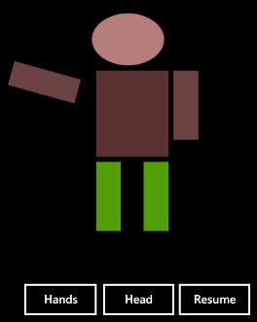
XAML Defining (Part 4: Your Animation Objects)
<Button Content="Resume" Height="72" HorizontalAlignment="Left" Margin="285,508,0,0" Name="btnResume" VerticalAlignment="Top" Width="134" Click="btnResume_Click" FontSize="18" />
<Button Content="Hands" Height="72" HorizontalAlignment="Left" Margin="48,508,0,0" Name="btnArmPause" VerticalAlignment="Top" Width="135" Click="btnArmPause_Click" FontSize="18" />
<Button Content="Head" Height="72" HorizontalAlignment="Right" Margin="0,508,154,0" Name="btnHeadPause" VerticalAlignment="Top" Width="133" FontSize="18" Click="btnHeadPause_Click" />
</Grid>
</Grid>
</phone:PhoneApplicationPage>

Slide 24
Code Behind the GUI: MainPage.xaml.cs (1)
namespace MyPhoneAnimation {
public partial class MainPage : PhoneApplicationPage {
DateTime startTime;
int resume = 1;
public MainPage() {
InitializeComponent();
startTime = DateTime.Now;
CompositionTarget.Rendering += OnCompositionTargetRendering;
myStoryboard.Begin();
}
void OnCompositionTargetRendering(object sender, EventArgs args) {
// Angle directly controlled rotation
rightArm.Angle = (rightArm.Angle + resume * 0.5) % 360;
// Time-controlled rotation
TimeSpan elapsedTime = DateTime.Now - startTime;
leftArm.Angle = resume * elapsedTime.TotalMinutes * 1000;
}

Slide 25
Code Behind the GUI: MainPage.xaml.cs (1)
private void btnResume_Click(object sender, RoutedEventArgs e) {
resume = -1; // Start to rotation in opposite direction
myStoryboard.Begin(); // Start head movement
}
private void btnArmPause_Click(object sender, RoutedEventArgs e) {
// Thread.Sleep(10000); // you could pause for a given amount of time
resume = 0; // arm rotations stop
}
private void btnHeadPause_Click(object sender, RoutedEventArgs e) {
myStoryboard.Pause(); // head pause
}
}
}
1. How do you control the execution of the animation programmed in C#?
(A) Using Thread.Sleep(); (B) Using myStoryboard.Pause();
2. How do you manage the animation programmed in XAML Storyboard?
(A) Using Thread.Sleep(); (B) Using myStoryboard.Pause();

Slide 26
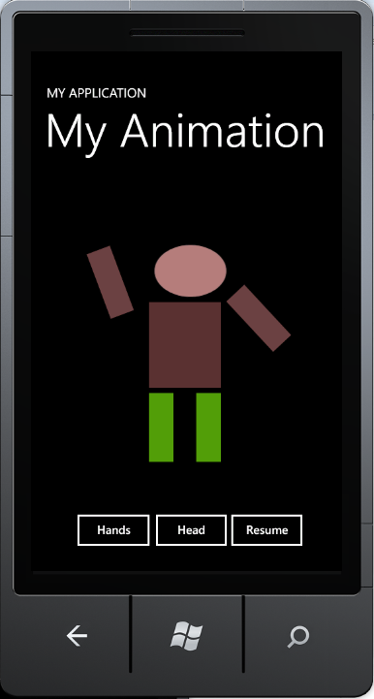
Demonstration

Slide 27
Phone 8 Apps Development Using Visual Studio 2013 and Windows 8
In VS 2013:
Choose Online Template
Choose C# and Windows Phone Template
Let Phone 8 SKD to be installed
Downloads:
Resources: http://msdn.microsoft.com/en-us/students-develop-msdn
Getting Started: http://go.microsoft.com/?linkid=9823885

Slide 28
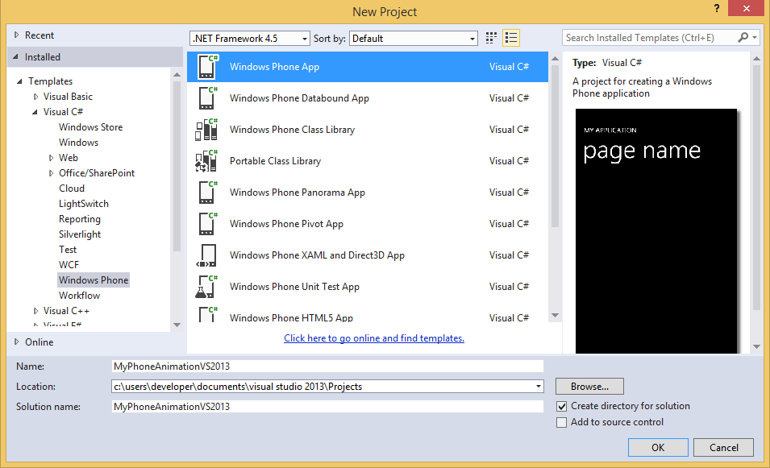
Phone 8 in VS 2013 and Windows 8
Create a new Windows Phone App in VS2013

Slide 29
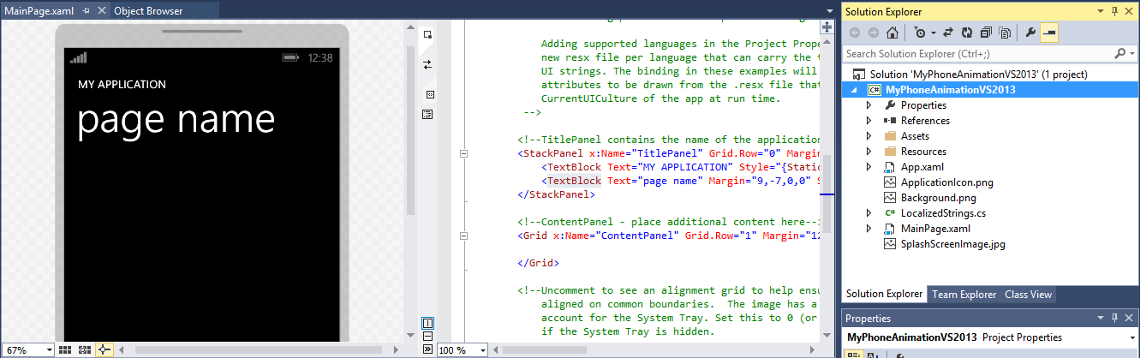
Main Page XAML View for GUI Design

Slide 30
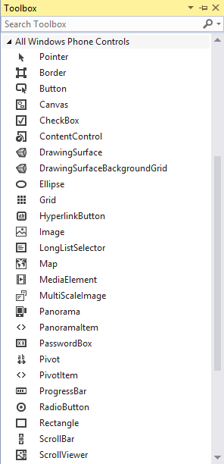
Put it in a Phone Application
Start a new phone project “MyPhoneAnimationVS2013”

Slide 31
Code Changes in Phone 8 App
Code developed in Phone 7 simply works for Phone 8. The only changes we made was due to the project name change:
The application name is changed from “MyPhoneAnimation” to “MyPhoneAnimationVS2013”, the following two parts of codes (VS2010) need to change their application names. All other codes can be reused.
UserControl:
UserControl x:Class="SilverlightTranslateTransformAnimationVS2013.MainPage
MainPage.xaml:
phone:PhoneApplicationPage
x:Class="MyPhoneAnimationVS2013.MainPage"

Slide 32
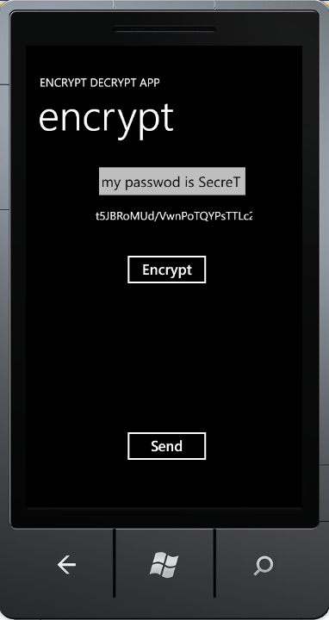
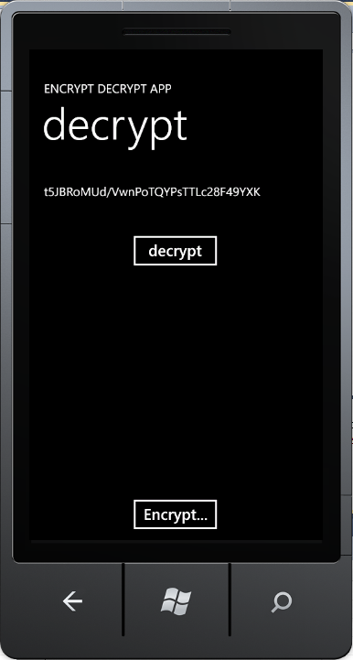
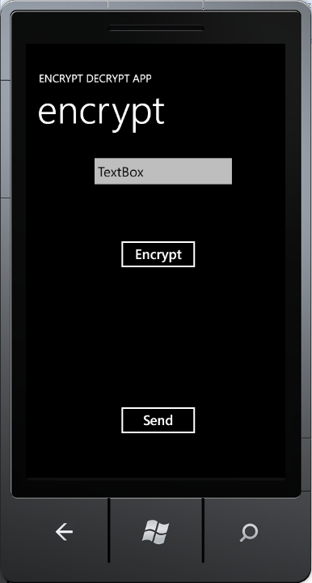

Case Study: Secure Phone Messenger
Phone apps rely on Web services to provide necessary functionalities;
Develop a secure phone messenger among friends and business partners

Slide 33
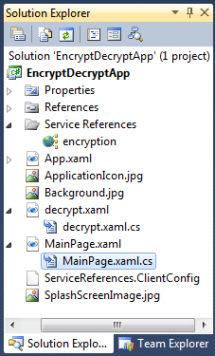
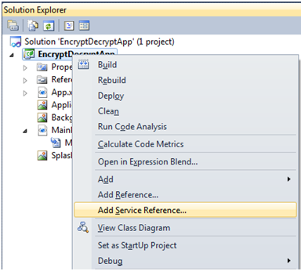
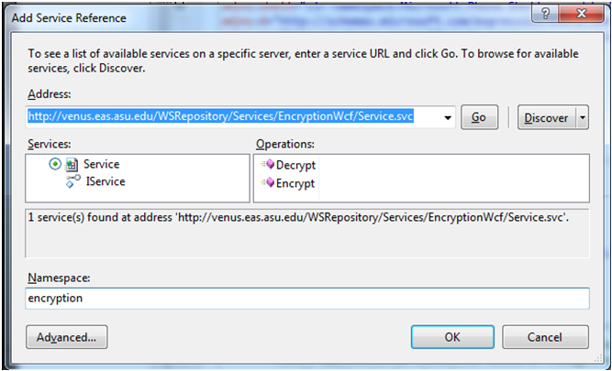
Add Encryption/Decryption Service

Slide 34

Code Behind GUI: MainPage.xaml.cs (1)
namespace EncryptDecryptApp {
public partial class MainPage : PhoneApplicationPage {
public string msgEncrypted;
public MainPage() // Constructor { InitializeComponent(); }
protected override void OnNavigatedTo(System.Windows.Navigation.NavigationEventArgs e) {
base.OnNavigatedTo(e); // try to receive msg from another page
string msg = "";
// Retrieve the string that is passed in the navigation URI
if (NavigationContext.QueryString.TryGetValue("msg", out msg))
textBlock1.Text = msg; // put the received data TextBox automatically
}
// continued next page

Slide 35


Code Behind GUI: MainPage.xaml.cs (2)
// namespace EncryptDecryptApp {
private void Encrypt_Click(object sender, RoutedEventArgs e) {
string msg1 = textBox1.Text;
encryption.ServiceClient prxyEncrypt = new encryption.ServiceClient();
prxyEncrypt.EncryptCompleted += new EventHandler<EncryptCompletedEventArgs>(prxyEncrypt_EncryptAsync);
prxyEncrypt.EncryptAsync(msg1); // call encryption service
EventHandler<System.ComponentModel.AsyncCompletedEventArgs> (prxyEncrypt_CloseCompleted);
}
private void prxyEncrypt_EncryptAsync(object sender, EncryptCompletedEventArgs e) {
textBlock1.Text = e.Result;
}
private void send_Click(object sender, RoutedEventArgs e) {
this.NavigationService.Navigate(new Uri("/decrypt.xaml?msg=" + textBlock1.Text, UriKind.Relative));
} } }
Could be a global URI

Slide 36

Code Behind the Other GUI Page: decrypt.xaml.cs (1)
namespace EncryptDecryptApp {
public partial class decrypt : PhoneApplicationPage {
public decrypt() { InitializeComponent(); }
protected override void OnNavigatedTo(System.Windows.Navigation.NavigationEventArgs e) {
base.OnNavigatedTo(e); // try to receive msg from another page
string msg = "";
// Retrieve the query string values that were passed in the navigation URI
if (NavigationContext.QueryString.TryGetValue("msg", out msg))
textBlock1.Text = msg; // put the received data TextBox automatically
}

Slide 37


Code Behind GUI: decrypt.xaml.cs (2)
// namespace EncryptDecryptApp {
private void decrypt_Click(object sender, RoutedEventArgs e) {
string msgEncrypted = textBlock1.Text;
encryption.ServiceClient prxyEncrypt = new encryption.ServiceClient();
prxyEncrypt.DecryptCompleted += new EventHandler<DecryptCompletedEventArgs>(prxyEncrypt_DecryptAsync);
prxyEncrypt.DecryptAsync(msgEncrypted);
}
private void prxyEncrypt_DecryptAsync(object sender, DecryptCompletedEventArgs e) {
textBlock1.Text = e.Result;
}
private void Encrypt_Click(object sender, RoutedEventArgs e) {
string msg = "";
this.NavigationService.Navigate (new Uri("/MainPage.xaml?msg=" + msg, UriKind.Relative));
} } }
Could be a global URI

Slide 38
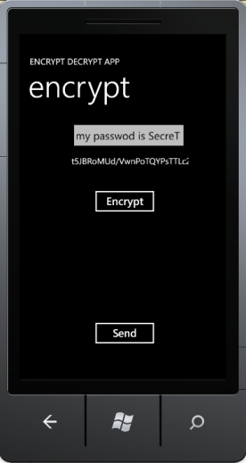
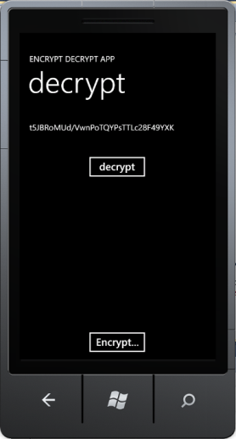
How Do We Send Message to Another Real Phone?
this.NavigationService.Navigate(new Uri("/MainPage.xaml?msg=" + msg, UriKind.Relative))
This RESTful service call transfer data to the REST service at the given URL;
The two pages are in the same solution and we can use local URL
Another real phone does not have a URL.
Message Queue Service
Take CSE446 or read text chapter 8 to learn message-based integration and asynchronous communication.

Slide 39
If SSL is not supported, then
Encryption Decryption Service
SSL is necessary
SSL is necessary
Clear text
Clear text
Encrypted text
Encrypted text
Message Queue Service
Encrypted text
Encrypted text stored
Encrypted text
Or use local DLL
SSL does not help
Or use local DLL

Slide 40
How are Confidentiality Guaranteed?
Built-in encryption/ decryption
Built-in encryption/ decryption
Message Queue Service
Encrypted text
Encrypted text stored
Encrypted text

Slide 41
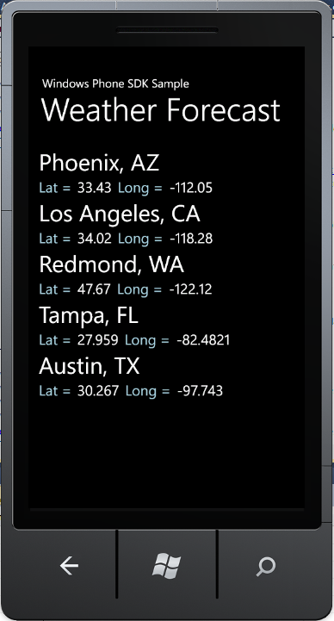
Case Study: Weather Forecast App
Microsoft Windows Phone Samples: http://go.microsoft.com/fwlink/?LinkID=219604
Download the Weather Forecast Sample:
This sample shows how you can call and process data from a web service in a Windows Phone application.
The sample uses the RESTful service call HttpWebRequest class to make an asynchronous call to a web service that provides weather forecast services: 7-day forecast data downloadable in the format of http://forecast.weather.gov/MapClick.php?lat=33.43417&lon=-112.05111&FcstType=dwml

Slide 42
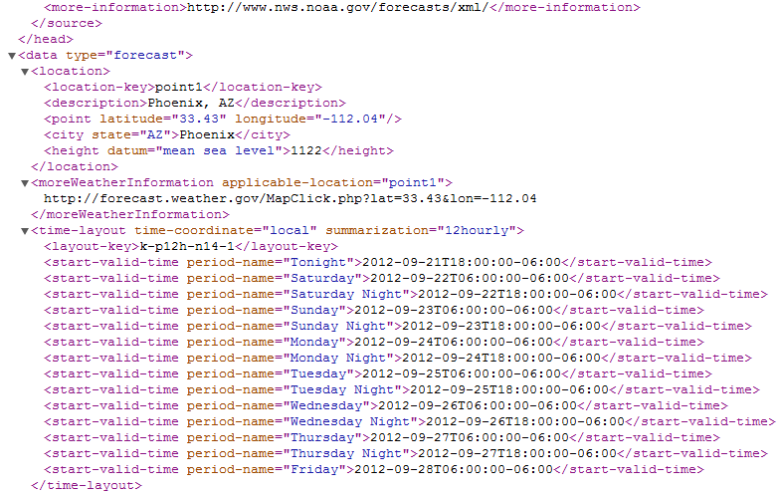
Phoenix Seven-Day Weather Data Download: http://forecast.weather.gov/MapClick.php?lat=33.43417&lon=-112.05111&FcstType=dwml

Slide 43
To Get Forecast from the URL http://forecast.weather.gov/MapClick.php?lat=33.43&lon=-112.04&FcstType=dwml
// The operation takes latitude and longitude as inputs, and obtain 7-day forecast
public void GetForecast(string latitude, string longitude) {
// form the URI
UriBuilder fullUri = new UriBuilder("http://forecast.weather.gov/MapClick.php");
fullUri.Query = "lat=" + latitude + "&lon=" + longitude + "&FcstType=dwml";
// initialize a new WebRequest: RESTful style service access
HttpWebRequest forecastRequest = (HttpWebRequest)WebRequest.Create(fullUri.Uri);
// set up the state object for the async request
ForecastUpdateState forecastState = new ForecastUpdateState();
forecastState.AsyncRequest = forecastRequest;
// start the asynchronous request
forecastRequest.BeginGetResponse(
new AsyncCallback(HandleForecastResponse), forecastState);
}
Asynchronous call (first half) with a callback after the data are available.
Take CSE446 or read text chapter 7 to learn asynchronous communication.

Slide 44
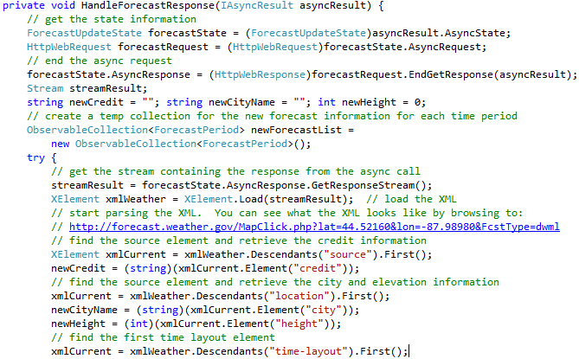
Callback Handler to Retrieve Forecast Response
Make request
Retrieve the data
Read Text 10.4.5: LINQ to XML Processing

Slide 45
Asynchronous Call Implemented
In the method GetForecast(latitude, longitude), the phone (client) makes an initial request, with a callback method name HandleForecastResponse as parameter;
The method terminates and the phone can perform other tasks;
The weather service prepares the data and trigger a remote event to HandleForecastResponse, in which a second call is made to the service to retreive the response data

Slide 46
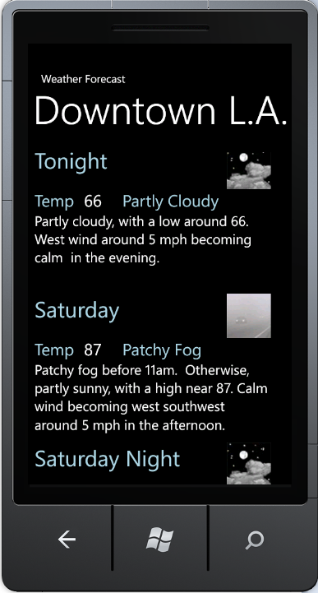
Extract and Display the Weather Info

Slide 47
More Examples
Developing a Robotics Application
Web Application
Phone Application

Slide 48
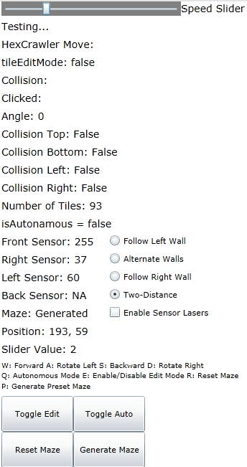
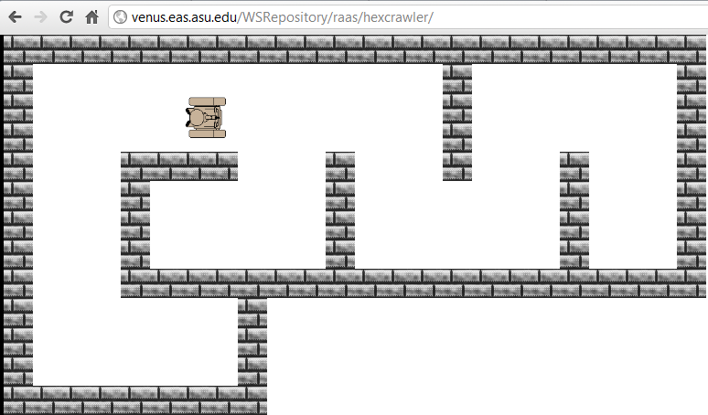
Silverlight Web App 1
http://venus.eas.asu.edu/WSRepository/raas/hexcrawler/

Slide 49
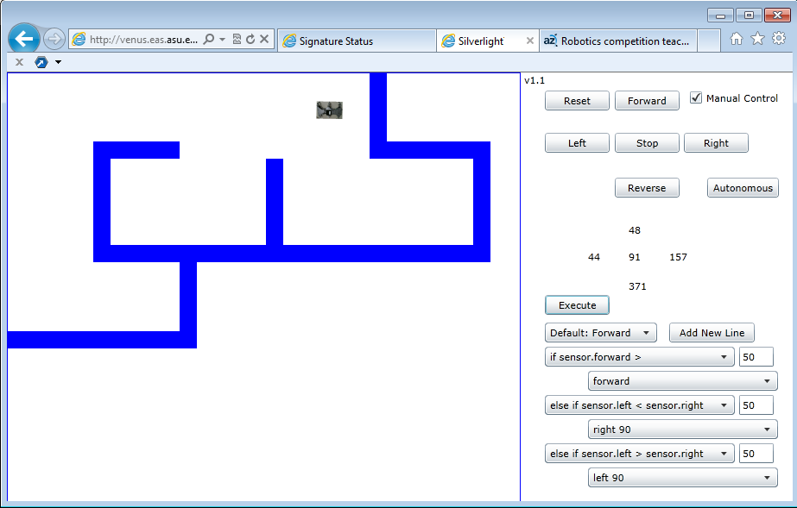
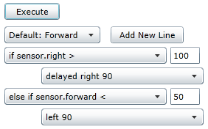
Silverlight Web App 2: With Programming Capacity
http://venus.eas.asu.edu/WSRepository/RaaS/MazeNav/
Farthest Difference Algorithm
Right-Wall-Following Algorithm

Slide 50
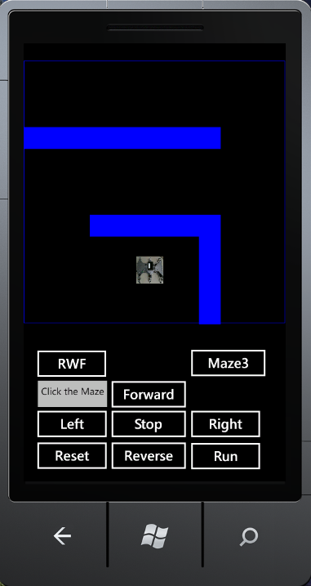
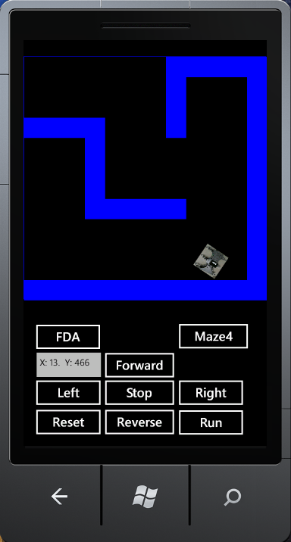
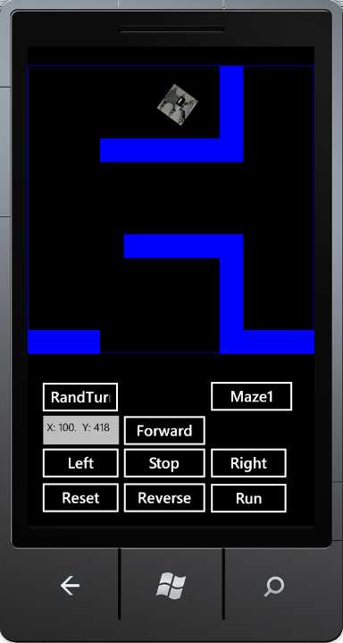
Phone App: Change Maze and Drive

Slide 51
MainPage.xaml Defines Phone GUI
<phone:PhoneApplicationPage
<Grid x:Name="LayoutRoot" Background="Transparent">
<Grid.RowDefinitions> <RowDefinition Height="Auto"/> <RowDefinition Height="*"/> </Grid.RowDefinitions>
<Grid x:Name="ContentPanel" Margin="12,37,12,0" ShowGridLines="True" Height="875" VerticalAlignment="Top" Grid.RowSpan="2">
<Button Content="Forward" Height="72" HorizontalAlignment="Left" Margin="125,533,0,0" Name="forwardButton" VerticalAlignment="Top" Width="160" Click="forwardButton_Click" />
<Button Content="Left" Height="72" HorizontalAlignment="Left" Margin="-5,590,0,0" Name="leftButton" VerticalAlignment="Top" Width="160" Click="leftButton_Click" />
<Button Content="Stop" Height="72" HorizontalAlignment="Left" Margin="125,590,0,0" Name="stopButton" VerticalAlignment="Top" Width="160" Click="stopButton_Click" />
<Button Content="Reverse" Height="72" HorizontalAlignment="Left" Margin="125,649,0,0" Name="reverseButton" VerticalAlignment="Top" Width="160" Click="reverseButton_Click" />
<CheckBox Content="CheckBox" Height="72" HorizontalAlignment="Left" Margin="285,522,0,0" Name="manualControlCheckBox" VerticalAlignment="Top" Checked="manualControlCheckBox_Click" />
<Button Content="Autonomous" Height="72" HorizontalAlignment="Left" Margin="265,649,0,0" Name="autonomousButton" VerticalAlignment="Top" Width="160" Click="autonomousButton_Click" />
<TextBox Height="72" HorizontalAlignment="Left" Margin="-5,643,0,0" Name="textBox1" Text="TextBox" VerticalAlignment="Top" Width="151" FontSize="18" />
<Button Content="Right" Height="72" HorizontalAlignment="Left" Margin="265,590,0,0" Name="rightButton" VerticalAlignment="Top" Width="160" Click="rightButton_Click" />
</Grid>
<!--TitlePanel contains the name of the application and page title-->
<StackPanel x:Name="TitlePanel" Grid.Row="0" Margin="12,17,0,28"></StackPanel>
<Canvas Height="560" HorizontalAlignment="Left" Name="canvas1" VerticalAlignment="Top" Width="480" Grid.RowSpan="2">
<Image Height="50" Name="theRobot" Stretch="Fill" Width="50" Source="/RobotSimulatorForWP;component/Images/Robot.jpg" Canvas.Left="121" Canvas.Top="357" />
</Canvas>
<!--ContentPanel - place additional content here-->
</Grid>
</phone:PhoneApplicationPage>

Slide 52
MainPage.xaml.cs Code Behind GUI: Buttons
private void forwardButton_Click(object sender, RoutedEventArgs e) {
manualControlCheckBox.IsChecked = true; autonomousActive = false;
move("forward");
}
private void leftButton_Click(object sender, RoutedEventArgs e) {
manualControlCheckBox.IsChecked = true; autonomousActive = false;
move("left");
}
private void rightButton_Click(object sender, RoutedEventArgs e) {
manualControlCheckBox.IsChecked = true; autonomousActive = false;
move("right");
}
private void reverseButton_Click(object sender, RoutedEventArgs e) {
manualControlCheckBox.IsChecked = true; autonomousActive = false;
move("reverse");
}
private void stopButton_Click(object sender, RoutedEventArgs e) {
manualControlCheckBox.IsChecked = true; autonomousActive = false;
move("stop");
}

Slide 53
MainPage.xaml.cs Code Behind GUI: move()
public void
(string direction) { // Configure the animation in Silverlight to do
// the correct action based on the motion received.
if (direction == "stop") {
CompositionTarget.Rendering -= updateFrame;
motion = direction;
}
else if (motion != direction) { // Check if not already going that same direction
if (motion != "stop") { // Check if already moving; It is moving; Stop moving
CompositionTarget.Rendering -= updateFrame;
motion = direction; // Move in the new direction.
CompositionTarget.Rendering += updateFrame;
}
else { // It is already stopped {
motion = direction; // Move right.
CompositionTarget.Rendering += updateFrame;
}
}
// Else: it is already moving the correct direction. Do nothing.
}

Slide 54
MainPage.xaml.cs Code Behind GUI: TurnLeft90
private void turnLeft90() {
double originalCompassReading = 400;
originalCompassReading = crossThreadSensorRead("compass");
double newDirection = originalCompassReading - 90;
if (newDirection < 0)
newDirection += 360;
crossThreadMoveCall("left");
double newReading = 400;
while (true) {
newReading = crossThreadSensorRead("compass");
if (newReading < 0)
newReading += 360;
if (differenceInAngles(newReading, newDirection) >= -2)
break;
}
crossThreadMoveCall("stop");
wantedAngle -= 90;
if (wantedAngle < 0)
wantedAngle += 360;
}

Slide 55
MainPage.xaml.cs Code Behind GUI: Key Down
private void KeyDownHandler(object sender, KeyEventArgs e) {
if (e.Key == Key.Up) {
if (manualControlCheckBox.IsChecked == false) {
manualControlCheckBox.IsChecked = true; setButtonEnables(); }
autonomousActive = false; move("forward");
}
else if (e.Key == Key.Left) {
if (manualControlCheckBox.IsChecked == false) {
manualControlCheckBox.IsChecked = true; setButtonEnables(); }
autonomousActive = false; move("left");
}
else if (e.Key == Key.Right) {
if (manualControlCheckBox.IsChecked == false) {
manualControlCheckBox.IsChecked = true; setButtonEnables(); }
autonomousActive = false; move("right");
}
else if (e.Key == Key.Down) {
if (manualControlCheckBox.IsChecked == false) {
manualControlCheckBox.IsChecked = true; setButtonEnables(); }
autonomousActive = false; move("reverse");
} }

Slide 56
MainPage.xaml.cs Code Behind GUI: Key Up
private void KeyUpHandler(object sender, KeyEventArgs e)
{
if (e.Key == Key.Up || e.Key == Key.Left || e.Key == Key.Down || e.Key == Key.Right)
{
if (manualControlCheckBox.IsChecked == false)
{
manualControlCheckBox.IsChecked = true;
setButtonEnables();
}
autonomousActive = false;
move("stop");
}
}

Slide 57
MainPage.xaml.cs Code Behind GUI: Mouse Click
private void mouseDownClick_Handler(object sender, GestureEventArgs e) {
int mouseXPos = Convert.ToInt32(e.GetPosition(null).X);
int mouseYPos = Convert.ToInt32(e.GetPosition(null).Y);
// This is a WP fix. When clicking it is offset by +30 on the Y-axis.
mouseYPos -= 30;
// Make sure the mouse-click occurred inside the "playable" region.
if (mouseXPos < worldSize && mouseYPos < worldSize) {
// Deplaying info in textbox
textBox1.Text = "X: " + mouseXPos.ToString() + ". Y: " + mouseYPos.ToString();
// Determine what "block"/"square" the mouse is in
int blockX = (mouseXPos / blockSize);
int blockY = (mouseYPos / blockSize);
int blockXPos = blockX * blockSize;
int blockYPos = blockY * blockSize;
toggleBlockNumber(blockX, blockY);
}
}
Not all event handlers are given here.

Slide 58
Deploy Phone App to Real Device
Registration
You must register an account as a Windows Phone developer.
Free for DreamSpark student, and otherwise $99/year
MS will make acceptance test before release your apps to Apps Store;
The profit will be shared between you and Apps Store;
Deployment to your own phone:
Connect your phone to your computer through USB;
Your phone should appear in Zune software, assuming that you have installed Zune software;
You may also download Windows Phone Developer Tools RTW, instead of using Visual Studio
http://www.microsoft.com/en-us/download/details.aspx?id=13890

Slide 59
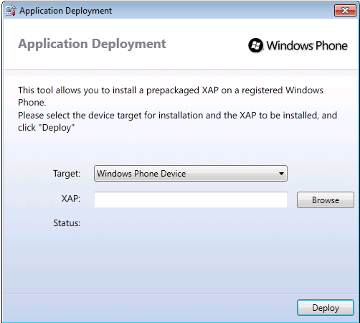

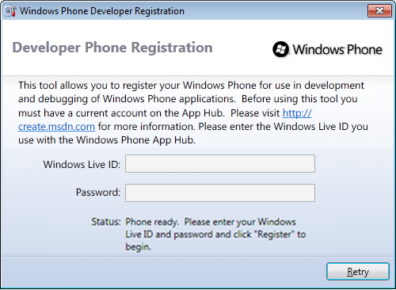
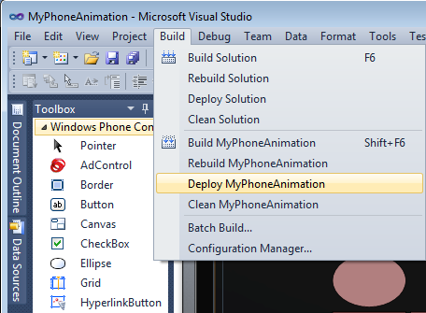
Register Your Phone and Link it in the Development Tool
Change Phone Emulator to Device
Start Menu Search
MyAnimation.xap

Slide 60
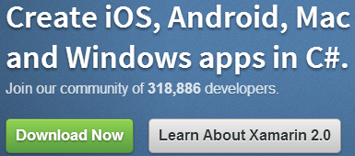
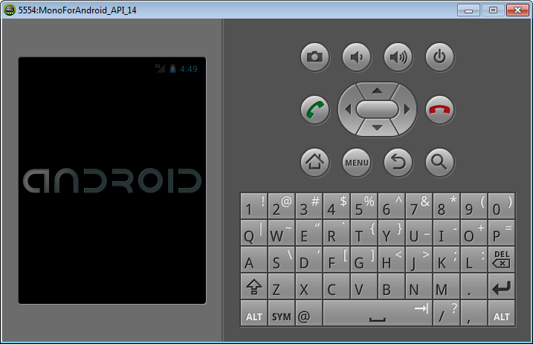

Develop Phone Apps on Other Platforms
You can download an other development SDKs to Visual Studio
develop C# phone apps on other platforms,
Android and
iPhone
For example: http://xamarin.com/

Slide 61
Lecture Summary
Getting Started with Hello Phone application
Creating Animations in Phone Apps
Using XAML
Using Code behind Page
Calling Web services in Phone Apps
Secure Messenger Using Encryption/Decryption Service
Weather Service Using National Weather Service
Complex Applications
Robotics Applications and GUI-based Programming

